Slide 1
Chapter 3

Slide 2

Topics
Arrays
Singly Linked Lists
Doubly Linked Lists
Circularly List Lists and List Reversal
Recursion

Slide 3
Arrays

Slide 4
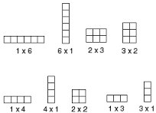
Arrays
Collection of n elements stored in a linear order
Same type
Range [0,n-1]
Index of an element is the number of elements that precede the element
C++ does not have built-in boundary checking

Slide 5

Array Lists (1)
An array is a fixed-size data structure
Once an array is created, its size cannot be changed
Nevertheless, one can still use arrays to implement dynamic data structures
The trick is to create a new larger array to replace the current array if the current array cannot hold the new elements

Slide 6
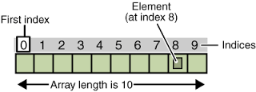
Array Lists (2)
Initially, an array is created with a default size
When inserting a new element into the array, first ensure there is enough room in the array
If not, create a new array (with the size twice as the current one)
Copy the elements from the current array to the new array
The new array now becomes the current array

Slide 7

Insertion within an Array
Before inserting a new element at a specified index, shift all the elements after the index to the right and increase the list size by 1

Slide 8
Deletion within an Array
To remove an element at a specified index, shift all the elements after the index to the left by one position and decrease the list size by 1

Slide 9

Sample Code using Arrays
See examples: array1 – array7

Slide 10
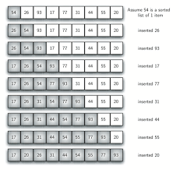
Sorting an Array
The insertion sort algorithm sorts a list of values by repeatedly inserting an unsorted element into a sorted sub-list until the whole list is sorted

Slide 11
Insertion Sort
int[] myList = {2, 9, 5, 4, 8, 1, 6}; // unsorted
2 | 9 | 5 | 4 | 8 | 1 | 6
2 | 9 | 5 | 4 | 8 | 1 | 6
2 | 5 | 9 | 4 | 8 | 1 | 6
2 | 4 | 5 | 9 | 8 | 1 | 6
2 | 4 | 5 | 8 | 9 | 1 | 6
1 | 2 | 4 | 5 | 8 | 9 | 6
1 | 2 | 4 | 5 | 6 | 8 | 9

Slide 12
Insertion Sort

Slide 13
Insertion Sort
insertionSort(char* A, int n) { // sort an array of n characters
for (int i = 1; i < n; i++) { // insertion loop
char cur = A[i]; // current character to insert
int j = i - 1; // start at previous character
while ((j >= 0) && (A[j] > cur)) { // while A[j] is out of order
A[j + 1] = A[j]; // move A[j] right
j--; // decrement j
}
A[j + 1] = cur; // this is the proper place for cur
}
}

Slide 14
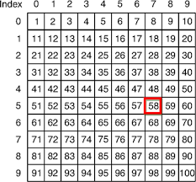
Limitation Summary of Arrays
Arrays are simple and easy to use, but they have two limitations
Once an array is created, its size cannot be altered
Array provides inadequate support for inserting, deleting, sorting, and searching operations
Not efficient

Slide 15
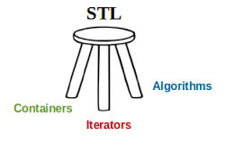
STL Containers
Container
An object that can hold other objects as its elements
Goal:
Create a container object that automatically grows or shrinks as needed
One way to accomplish this is to use a STL container class that manages a sequence of elements
Memory is allocated and de-allocated as needed

Slide 16
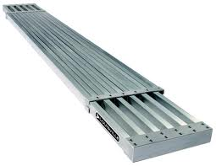
Vectors
A vector is similar to an array except that can automatically expand and contract as needed
The new and delete operators are not used by the programmer
The destructor is called when the elements of a vectors are all destroyed
Out of scope
A constructor can being called allocating an arbitrary number of elements

Slide 17
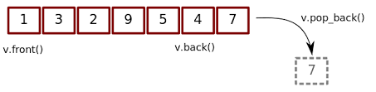
Vector Header File
<vector> - defines a template class for implementing a vector

Slide 18
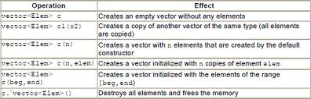
Vector Constructors
vector < type> v //construct v as a vector <type> of capacity 0
vector < type> v(n) //construct v as a vector <type> of capacity n, size n, and each element is initialized to the default type value
vector < type> v(n, initialValue) // construct v as a vector <type> of capacity n, size n, and each element is initialized to initialValue

Slide 19
Vector Member Functions (1)
Given vector <type> v
v.size( ) //returns the number of values v currently contains
v.empty( ) // is a faster alternative to the boolean expression v.size ( ) == 0
v.capacity ( ) //returns the current capacity of v
v.push_back(value) // append value at v’s end
v.reserve (n) //grows v so its capacity in n (does not affect v’s size)
v.pop_back( ) // erase v’s last element

Slide 20
Vector Member Functions (2)
v.front( ) // returns a reference to v’s first element
v.back( ) // returns a reference to v’s last element
v.begin( ) // returns a iterator positioned at v’s first value
v.end( ) // returns an iterator positioned immediately after v’s last value
v.insert(pos, value) // inserts value into v at iterator position pos
v.erase(pos) // erases the value in v at iterator position pos
v.erase(pos1, pos2) // erase the values in v from iterator position pos1 to pos2

Slide 21

The STL Vector Web Site
For all the vector constructors and methods
http://www.cplusplus.com/reference/vector/vector/
See examples: vector1 and vector2

Slide 22
Linked Lists

Slide 23
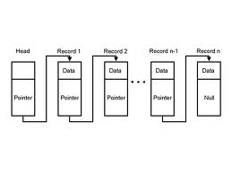
Linked Lists
The order of the components is determined by an explicit link member in each node
The list needs to be traverse to access nodes

Slide 24
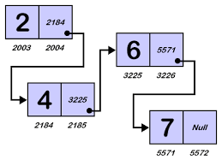
Singly Linked Lists (1)
A singly linked list is a concrete data structure consisting of a sequence of nodes

Slide 25
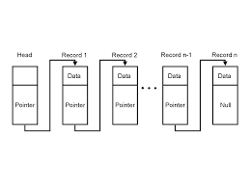
Singly Linked Lists (2)
Every node in a linked list has two components
A component member
A link member that gives the location of the next node in the list
The address of the first node of the list is stored in a separate location usually called the “head”

Slide 26
Singly Linked List Structure
next
elem
node
∅
A
B
C
D
head
tail
LAX
MSP
ATL
BOS
NULL

Slide 27
Insertion in a Singly Linked List (head)
head
tail
MSP
ATL
BOS
NULL
head
tail
LAX
MSP
ATL
BOS
NULL

Slide 28
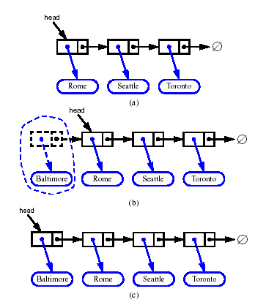
Inserting at the Head
Allocate a new node
Insert new element
Have new node point to old head
Update head to point to new node

Slide 29
Removing an Element in a Singly Linked List (head)
head
tail
LAX
MSP
ATL
BOS
NULL
head
tail
MSP
ATL
BOS
NULL

Slide 30
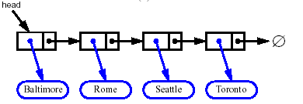


Removing at the Head
Update head to point to next node in the list
Allow garbage collector to reclaim the former first node

Slide 31
Insertion in a Singly Linked List (tail)
head
tail
head
MSP
ATL
BOS
NULL
tail
MSP
ATL
BOS
MIA
NULL

Slide 32
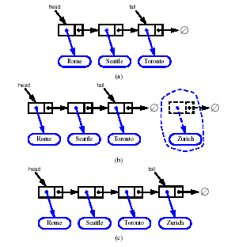
Inserting at the Tail
Allocate a new node
Insert new element
Have new node point to null
Have old last node point to new node
Update tail to point to new node

Slide 33
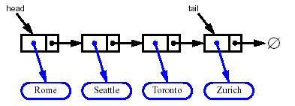
Removing at the Tail
Removing at the tail of a singly linked list is not efficient!
There is no constant-time way to update the tail to point to the previous node
Need to update the next link of the node immediately preceding the delete node
Should use doubly linked lists

Slide 34
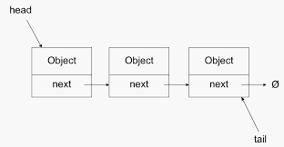
Implementing a Generic Linked List
See examples: linkedList1 and linkedList2

Slide 35
Doubly Linked Lists
A doubly linked list is a linked list in which every node has a next and a back pointer
A doubly linked list can be traversed in either direction
One can traverse the list starting at the first node or if a pointer to the last node is given, we can traverse the list starting at the last node
Quicker updates near the end of the list compared to a singly linked list
header
JFK
PVD
SFO
trailer

Slide 36
Doubly Linked Lists
prev
next
elem
node
header
JFK
PVD
SFO
trailer

Slide 37
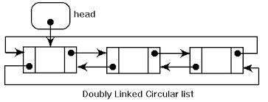
Header and Trailers
Option 1:
Separate header and trailer
One header, one trailer
Option 2:
Integrated header and trailer
Last node pointing to the first node

Slide 38
Insertion
One visualizes operation insert(p, x), which inserts x before p
p
a
b
c
p
a
b
c
q
x
q
p
a
b
x
c

Slide 39

Insertion Algorithm
Algorithm insert(p, e): {insert e before p}
Create a new node v
v→element = e
u = p→prev
v→next = p; p→prev = v {link in v before p}
v→prev = u; u→next = v {link in v after u}

Slide 40
Deletion Algorithm
We visualize remove(p)
p
a
b
c
d
a
b
c
p
d
a
b
c

Slide 41

Deletion Algorithm
Algorithm remove(p):
u = p→prev
w = p→next
u→next = w {linking out p}
w→prev = u
See example: linkedlist3

Slide 42

Circularly Link List
A linked list without head or tail
Traversal means circle through all nodes
Singly linked list where the last node points to the first node
Cursor allows one to have a place to start
Keeps track of where traversing commenced
Methods
Add node: insert after the cursor
Remove node: remove node immediately after the cursor
Advance node: advance the cursor to the next node

Slide 43
Circularly Link List
cursor
MSP
ATL
BOS
MIA

Slide 44
Circularly Linked Lists Methods (1)
front ()
Returns the element referenced by the cursor
Returns an error if the list is empty
back ()
Returns the element immediately after the cursor
Returns an error if the list is empty
advance ()
Advance the cursor to the next in the list
Returns an error if the list is empty

Slide 45
Circularly Linked Lists Methods (2)
add (e)
Insert a new node with element e immediately after the cursor
If the list is empty, then this node becomes the cursor and its next pointer points to itself
remove ()
Remove the node immediately after the cursor
Not the cursor itself unless it is the only node
If the list becomes empty, the cursor is set to null

Slide 46
Implementing a Circularly Linked List (1)
// A node of a circular linked list
typedef string Elem; // element type
class CNode { // circularly linked list node
private:
Elem elem; // linked list element value
CNode* next; // next item in the list
friend class CircleList; // provide CircleList access
};
3.28

Slide 47
Implementing a Circularly Linked List (2)
//Linked List Class
class CircleList { // a circularly linked list
public:
CircleList(); // constructor
~CircleList(); // destructor
bool empty() const; // is list empty?
const Elem& front() const; // element at cursor
const Elem& back() const; // element following cursor
void advance(); // advance cursor
void add(const Elem& e); // add after cursor
void remove(); // remove node after cursor
private:
CNode* cursor; // the cursor
};
3.29

Slide 48
Implementing a Circularly Linked List (3)
// constructor and destructor
CircleList::CircleList() // constructor
: cursor(NULL) { }
CircleList::~CircleList() // destructor
{ while (!empty()) remove(); }
// member functions
bool CircleList::empty() const // is list empty?
{ return cursor == NULL; }
const Elem& CircleList::back() const // element at cursor
{ return cursor->elem; }
const Elem& CircleList::front() const // element following cursor
{ return cursor->next->elem; }
void CircleList::advance() // advance cursor
{ cursor = cursor->next; }
3.30
3.31

Slide 49
Implementing a Circularly Linked List (4)
// Inserting a node just after the cursor
void CircleList::add(const Elem& e) { // add after cursor
CNode* v = new CNode; // create a new node
v->elem = e;
if (cursor == NULL) { // list is empty?
v->next = v; // v points to itself
cursor = v; // cursor points to v
}
else { // list is nonempty?
v->next = cursor->next; // link in v after cursor
cursor->next = v;
}
}
3.32

Slide 50
Implementing a Circularly Linked List (5)
// Removing a node following the cursor
void CircleList::remove() { // remove node after cursor
CNode* old = cursor->next; // the node being removed
if (old == cursor) // removing the only node?
cursor = NULL; // list is now empty
else
cursor->next = old->next; // link out the old node
delete old; // delete the old node
}
3.33

Slide 51
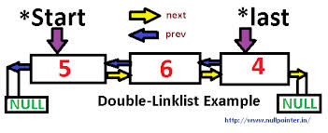
Reversing a Doubly Link List
Given a list L
Repeatedly extract the first element of L and copy to a temporary list T
Then copy the contents of T back to L

Slide 52
Using Recursion

Slide 53
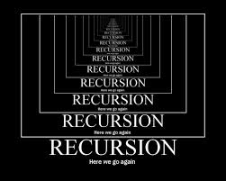
Recursion (1)
Recursion is when a function calls itself or calls a function which in turn calls the originating function
A recursive solution to a problem must be written carefully
Need to avoid making an infinite sequence of function calls (infinite recursion)
Each recursive algorithm must have at least one base case, as well as a general (recursive) case
One must supply an exit routine (make sure that code is not an endless loop)

Slide 54
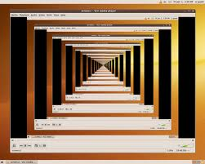
Recursion (2)
Recursion is used since some problems are easier to code using this technique
Recursive programs tend to use a lot of memory
Every recursive program can be rewritten with an iteration replacing the recursion
Conversely, every iteration can be written with recursion replacing iteration

Slide 55
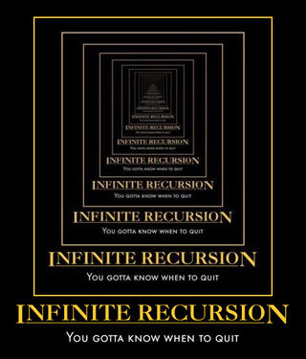
General format for Many Recursive Functions
if (some easily-solved condition) // base case
solution statement
else // general case
recursive function call

Slide 56

When a Function is called ... (1)
When any function is called the run-time stack is used
On this stack is placed an activation frame for each function call
The activation frame contains the return address for this function call, and also the parameters, and local variables, and space for the function’s return value, if non-void
These frames are put on a stack
They are destroyed in reverse order in which they are created
This stack is a last in/first out (LIFO)
There is a limit on the size of the stack

Slide 57
When a Function is called ... (2)
If the operating system runs out of stack space, there may be a stack overflow error or the computer may simply stop responding until a reboot
Stacks overflows are usually caused by infinite recursion
The activation frame for a particular function call is popped off the run-time stack when the final closing brace in the function code is reached, or when a return statement is reached in the function code
At this time the function’s return value, if non-void, is brought back to the calling block return address for use there

Slide 58

Linear Recursion (1)
Test for base cases
Begin by testing for a set of base cases (there should be at least one)
Every possible chain of recursive calls must eventually reach a base case, and the handling of each base case should not use recursion
Recur once
Perform a single recursive call
This step may have a test that decides which of several possible recursive calls to make, but it should ultimately make just one of these calls
Define each possible recursive call so that it makes progress towards a base case

Slide 59
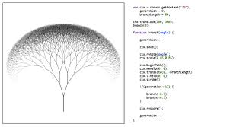
Linear Recursion (2)
Linear Recursion
Where a function is defined so that is makes at most one recursive call each time it is invoked
Useful when one views an algorithm problem in terms of a first or last element plus a remaining set that has the same structure as the original set

Slide 60
Summation
Writing a Recursive Function to Find the Sum of the Numbers from 1 to n called Summation
The sum of the numbers from 1 to n, that is,
1 + 2 + . . . + n can be written as
n + the sum of the numbers from 1 to (n - 1),
that is, n + 1 + 2 + . . . + (n-1)
or n + Summation(n - 1)

Slide 61
Summation(4) Trace of Call
Returns 4 + Summation(3) = 4 + 6 = 10
Call 1:
Summation(4)
Returns 3 + Summation(2) = 3 + 3 = 6
Call 2:
Summation(3)
Returns 2 + Summation(1)
= 2 + 1 = 3 Call 3:
Summation(2)
n==1
Returns 1
See example: recur1
Call 4:
Summation(1)
n
4
n
3
n
2
n
1

Slide 62
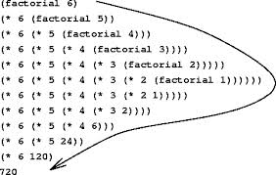
Factorial
Writing a Recursive Function to Find n Factorial
The function call Factorial(4) should have value 24, because that is 4 * 3 * 2 * 1 .
The value of Factorial(n) can be written as
n * the product of the numbers from (n - 1) to 1,
that is,
n * (n - 1) * . . . * 1
or, n * Factorial(n - 1)
See example: recur2

Slide 63
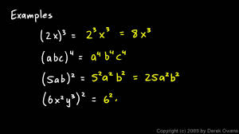
Other Examples Where Recursion Comes Naturally
2⁰ = 1 and 2⁵ = 2 * 2⁴
In general,
x⁰ = 1 and x^{n} = x * x^{n-1}
for integer x, and integer n > 0.
Here we are defining x^{n} recursively, in terms of x^{n-1}
See examples: recur3 and recur4

Slide 64
PrintStars(3) Trace of Call
Call 1:
PrintStars(3)
* is printed
Call 2:
PrintStars(2)
* is printed
Call 3:
PrintStars(1)
* is printed
See example: recur5
Call 4:
PrintStars(0)
Do nothing
n
3
n
2
n
1
n
0

Slide 65

Print an Array in Reverse using Recursion
See example: recur6

Slide 66
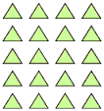
Summing the Elements of an Array using Recursion
The sum of all n integers in an Array, A
Is equal to A[0] is n is 1
If n is not 1, it is the sum of the first n – 1 integers plus the last element in A

Slide 67
LinearSum using Recursion
Example recursion trace:
linearSum(A,4)
Algorithm LinearSum(A, n):
Input:
A integer array A and an integer n = 1, such that A has at least n elements
Output:
The sum of the first n integers in A
if n = 1 then
return A[0]
else
return LinearSum(A, n - 1) + A[n - 1]
call
return
15
+
A
[
4
] =
15
+
5
=
20
LinearSum
(
A
,
5
)
call
return
13
+
A
[
3
] =
13
+
2
=
15
LinearSum
(
A
,
4
)
call
return
7
+
A
[
2
] =
7
+
6
=
13
LinearSum
(
A
,
3
)
call
return
4
+
A
[
1
] =
4
+
3
=
7
LinearSum
(
A
,
2
)
return
A
[
0
] =
call
4
LinearSum
(
A
,
1
)
A={4,3,6,2,5} where n = 5

Slide 68
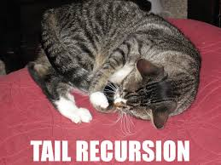
Tail Recursion
Tail recursion occurs when a linearly recursive method makes its recursive call as its last step

Slide 69
Reversing an Array
Algorithm ReverseArray(A, i, j):
Input: An array A and nonnegative integer indices i and j
Output: The reversal of the elements in A starting at index i and ending at j
if i < j then
Swap A[i] and A[ j]
ReverseArray(A, i + 1, j - 1)
return

Slide 70
IterativeReverseArray Recursion
Reversing an array not using recursion but using iterative calls
Algorithm IterativeReverseArray(A, i, j ):
Input: An array A and nonnegative integer indices i and j
Output: The reversal of the elements in A starting at index i and ending at j
while i < j do
Swap A[i ] and A[ j ]
i = i + 1
j = j - 1
return

Slide 71

Defining Arguments for Recursion
In creating recursive methods, it is important to define the methods in ways that facilitate recursion
This sometimes requires we define additional parameters that are passed to the method
For example, we defined the array reversal method as ReverseArray(A, i, j), not ReverseArray(A)

Slide 72
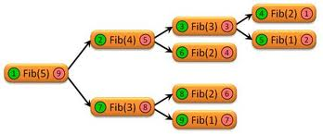
Binary Recursion
Binary Recursion
When an algorithm makes two recursive calls
Used to solve two similar halves of some problem

Slide 73
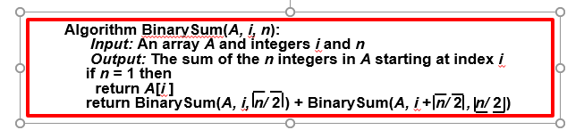
Binary Recursive Method
Problem: Add all the numbers in an integer array A:
Recursively sum the elements in the first half of A
Recursively sum the elements in the second half of A
Add the two numbers together

Slide 74
Binary Recursive Method
0
,
8
0
,
4
4
,
4
0
,
2
2
,
2
4
,
2
6
,
2
0
,
1
1
,
1
2
,
1
3
,
1
4
,
1
5
,
1
6
,
1
7
,
1
Height of the structure is 1 + log₂n
Let A = {5,6,1,7,8,3,5,9} – Find BinarySum (0,8)
i
, n
n
Where i is the starting index and n is the length

Slide 75

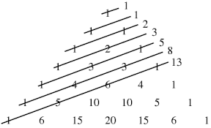
Fibonacci Numbers
0, 1, 1, 2, 3, 5, 8, 13, 21, 34, 55, 89, 144, 233, 377, 610, 987,…
The next number in the sequence is the sum of the previous two numbers

Slide 76
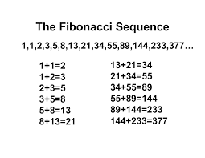
Computing Fibonacci Numbers
Fibonacci numbers are defined recursively:
F₀ = 0
F₁ = 1
F_{i} = F_{i-1} ⁺ F_{i-2} for i > 1
Recursive algorithm (first attempt):
Algorithm BinaryFib(k):
Input: Nonnegative integer k
Output: The kth Fibonacci number F_{k}
if k = 1 then
return k
else
return BinaryFib(k - 1) + BinaryFib(k - 2)
See example: recur7

Slide 77
Questions

Slide 78

Arrays vs Linked Lists
What structure would be best for
Sorting
Searching
Traversing
Inserting
Deleting
Accessing elements

Slide 79

Arrays vs Vectors
What are the benefits of using vectors instead of arrays?

Slide 80

Different Linked List Structures
When would one use a singly linked list vs a doubly linked list vs a circular linked list?

Slide 81
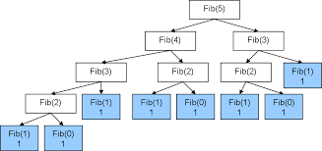
Recursion
When is recursion applicable?

Slide 82
When to Use Recursion
When the depth of the recursive class is relatively “shallow”
For example the number of recursive calls is relatively small for the binary search
When the recursive solution is shorter and simpler than the non recursive solution
Summation and factorial can easily be done without recursion
Calculated the Fibonacci numbers is easier using recursion
Reversing the elements of an array can be done with more clarity using recursion

